Slide 1
SAT Recommendations to College Board
Kevin WeE
Analyst, SAT insights Team

Slide 2
Problem Statement
The SAT and the ACT are standardized tests widely used for college admissions in the US.
Our competitors ACT have seen a steady increase in participation rates, and in 2012, surpassed the SAT for the first time in terms of total test takers.
Where we can best spend money to improve SAT participation rates in the US?
To address this problem statement, we performed an analysis on the 2017 and 2018 SAT and ACT data.

Slide 3
3 Key findings

Slide 4
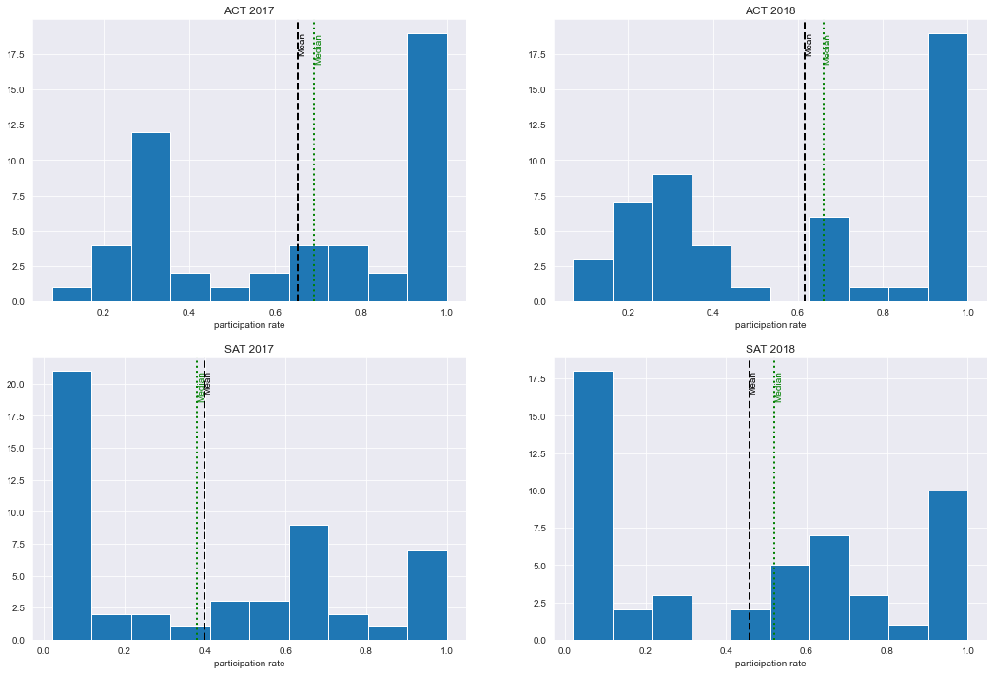
The SAT has seen moderate success in participation rates.
More states achieved 90% to 100% participation rates for SAT in 2018, from 7 in 2017 to 10 in 2018.
However, ACT participation rates remain largely unchanged, with more states in the 90% to 100% participation rate range compared to SAT

Slide 5
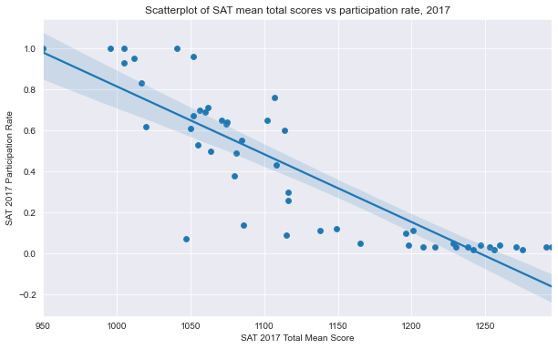
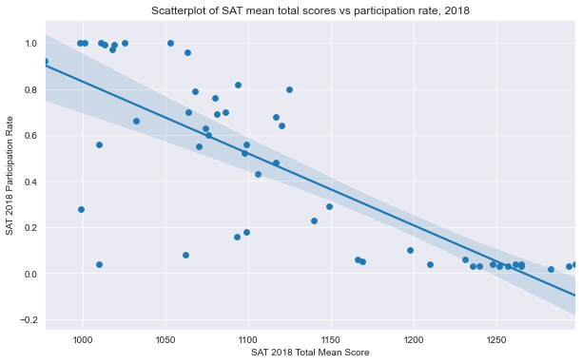
Increased participation rates are negatively correlated to test scores:
There could be 2 reasons to explain this phenomenon:
High achieving students also voluntarily took the ACT to boost their college admission chances
School systems were unprepared for changes to the examination policy (e.g. Illinois), which resulted in a dip in scores. This could be a short term phenomenon, but we will need more data (e.g. SAT scores over a longer timeframe) to determine this.

Slide 6
Public policy is a key driver to increasing SAT participation rates
States such as Colorado and Illinois had the biggest rate of increase in participation rate, at 89 % and 90% respectively, after SAT was mandated and administered in 2017.

Slide 7
3 Strategies

Slide 8
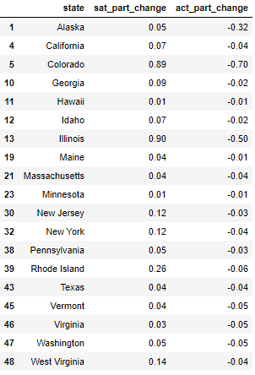
Target states that have yet to mandate any tests, and are more receptive towards SAT
This could give school systems ample lead time for preparation to change their systems, and as such could also see improvements in SAT scores.
The states that fit our criteria are Washington, California, Alaska, New York, Pennsylvania, Georgia and Texas

Slide 9
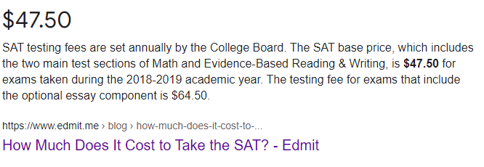
Provide SAT School Day for schools in the states we want to target
The cost of taking SAT could be a hefty amount of money for low income families. Hence, having SAT School Days will allow more students to take the test at no cost, thereby increasing participation rates.

Slide 10

Help students to gain awareness of free SAT resources, e.g. Khan academy
An increase in awareness of available tools and resources could help students better prepare for the SAT, and thus improve SAT scores and increase take up for SAT.

Slide 11
Thank you

